Slide 1
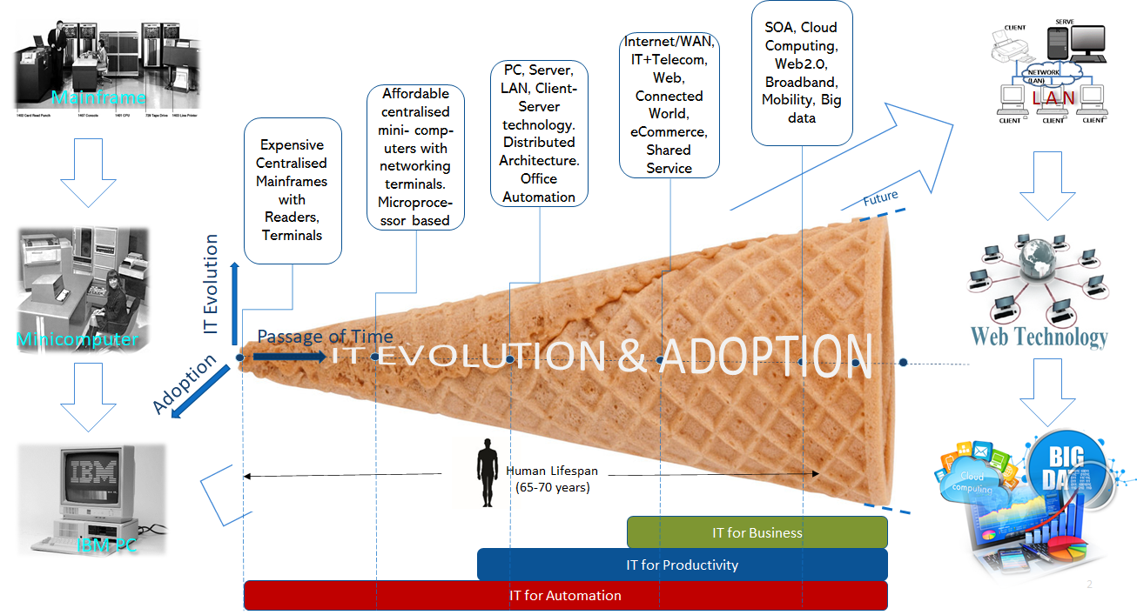
Recap: Evolution of ICT
MILESTONES
Mainframes and Minicomputers: Proprietary tech, Limited display, storage
IBM PC: File Sharing, End-user, MSDOS
Client Server Architecture
Networking and LAN
Packet Transfer (TCP/IP)
Internet
WWW, web Browser
Data Networks
Web Servers
Web Software/Apps
IPv6, Web 2.0
Digital Age
© Ashish Pachory

Slide 2
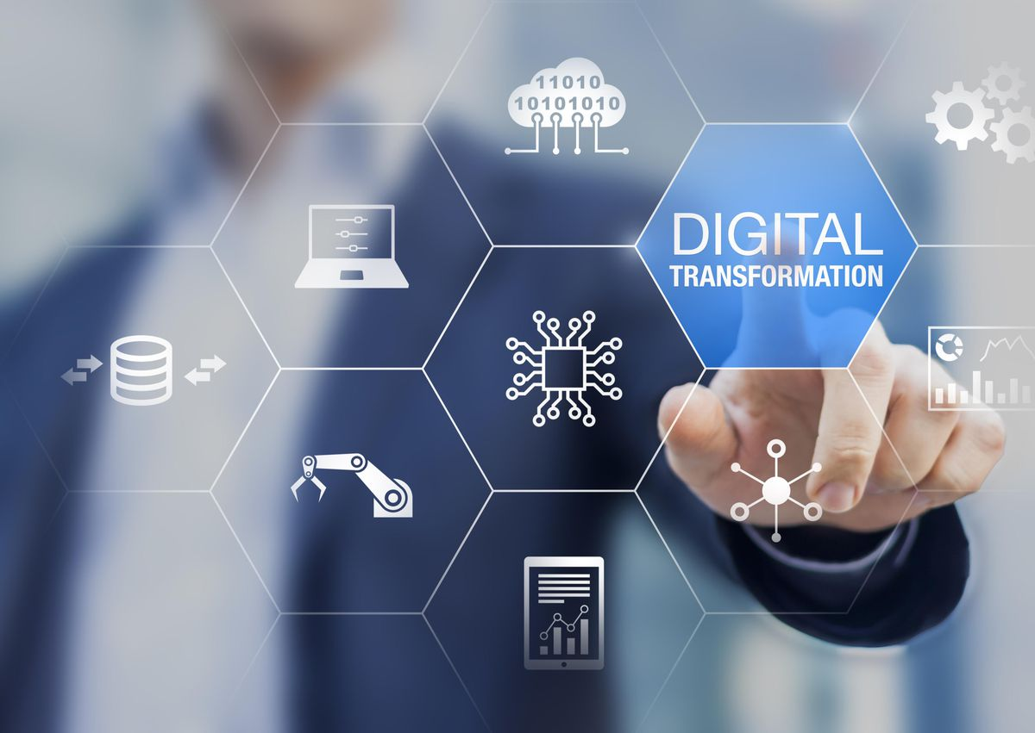
Lecture Series
The Digital Economy
Ashish Pachory

Slide 3
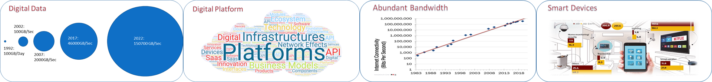
Defining the Digital Economy
What is the digital economy?
It is the economic activity resulting from the billions of online connections among People, Businesses, Data, Devices, and Processes on the Internet.
What are the main drivers of the digital economy?
Digital Data, Digital Platforms, Abundance of bandwidth, and Smart devices are the primary growth drivers of the digital economy.

Slide 4
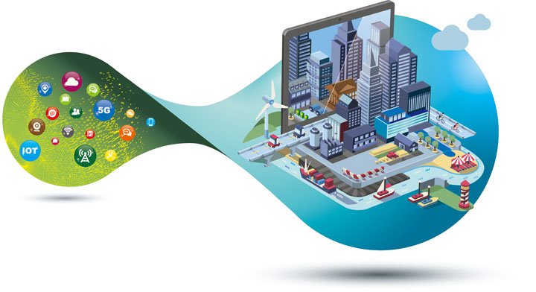
Some Key Outcomes of the Digital Economy
Levelling of the playing field
Globalization – demolition of geographical barriers
Lowering of entry barriers
Acceleration in pace of business (real-time transactions)
Proliferation of data – volume, velocity, variety
Innovative business models – platforms, aggregators
Superior Customer Experience – full cycle, personalization
Anytime, Anywhere access to information – work-from-home
Data as a business asset
Cashless economy
Data-driven insights and decision-making
Benefits for developing world
Cyber attacks
New avenues for fraud and crime (e.g. credit card fraud)
Privacy concerns
Disruption to traditional economy and jobs
Less community – faceless
Addictive nature of technology
Monopoly of tech giants (like Google, Amazon)

Slide 5
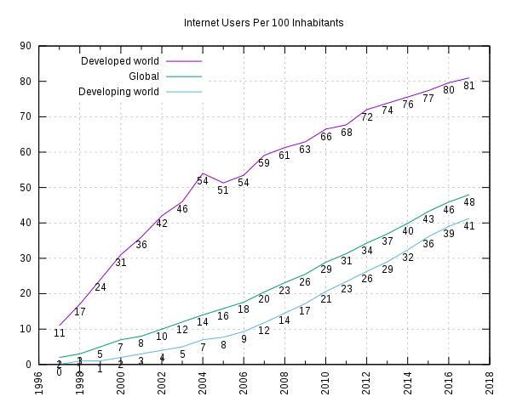
The Digital Divide

Slide 6
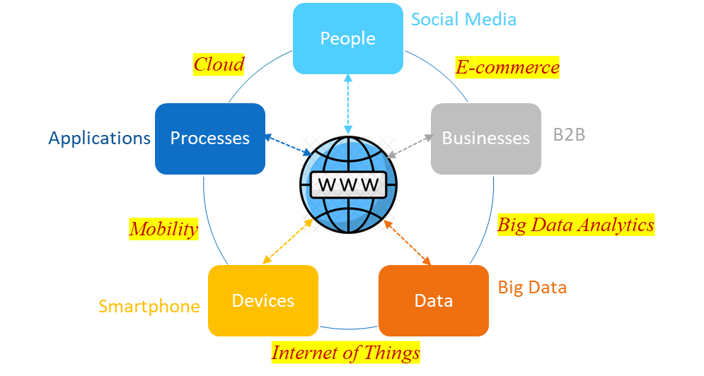
Key Participants in the Digital Economy
It changes everything.
© Ashish Pachory

Slide 7
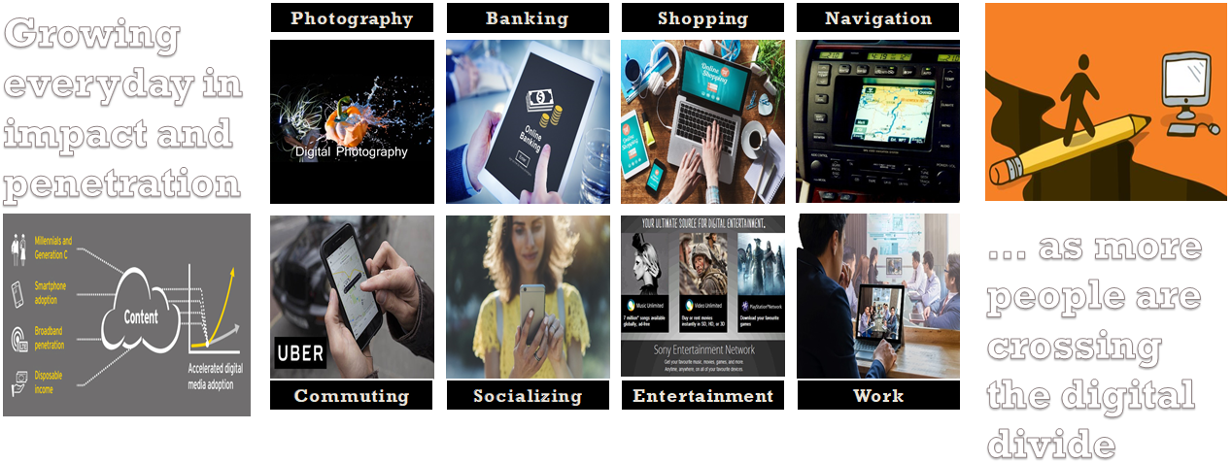
The Digital Economy is not just about Trade and Commerce. It is a Way of Life.
© Ashish Pachory

Slide 8


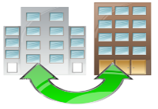
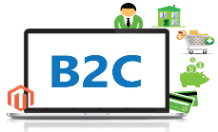



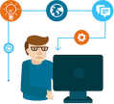





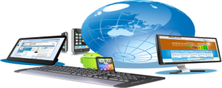











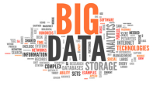


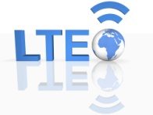

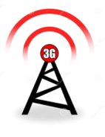

The Digital Enterprise Ecosystem
Emerging Markets
Networked Communities
B2B
B2C
B2B2C
Markets and Consumers
Technology Partners
Industry Association
Application Developers
OTT Players
Business Partners
✓ Products ✓ Services ✓ Experiences
Suppliers
Device Manufacturers
Partner Ecosystem
External Environment
Banks/FIs
Logistics Companies
The Digital Enterprise
Competitors
Content Partners
Government
Legal & Regulatory
Service Providers
Enabling Technology
Information
Communication
© Ashish Pachory

Slide 9
Self Assessment
1. What is the impact of a Digital Divide on students in developing countries?
2. What were the main drivers of business growth before the digital economy?
3. What are the major developments leading to the evolution of the digital economy?
4. How has the digital economy changed the travel industry? Give 3 examples.
5. What is a digital enterprise and what are its main pillars?
6. What is a B2B business? Give an example.
7. What does the intersection of Big Data and Processes/Applications create?

Slide 10
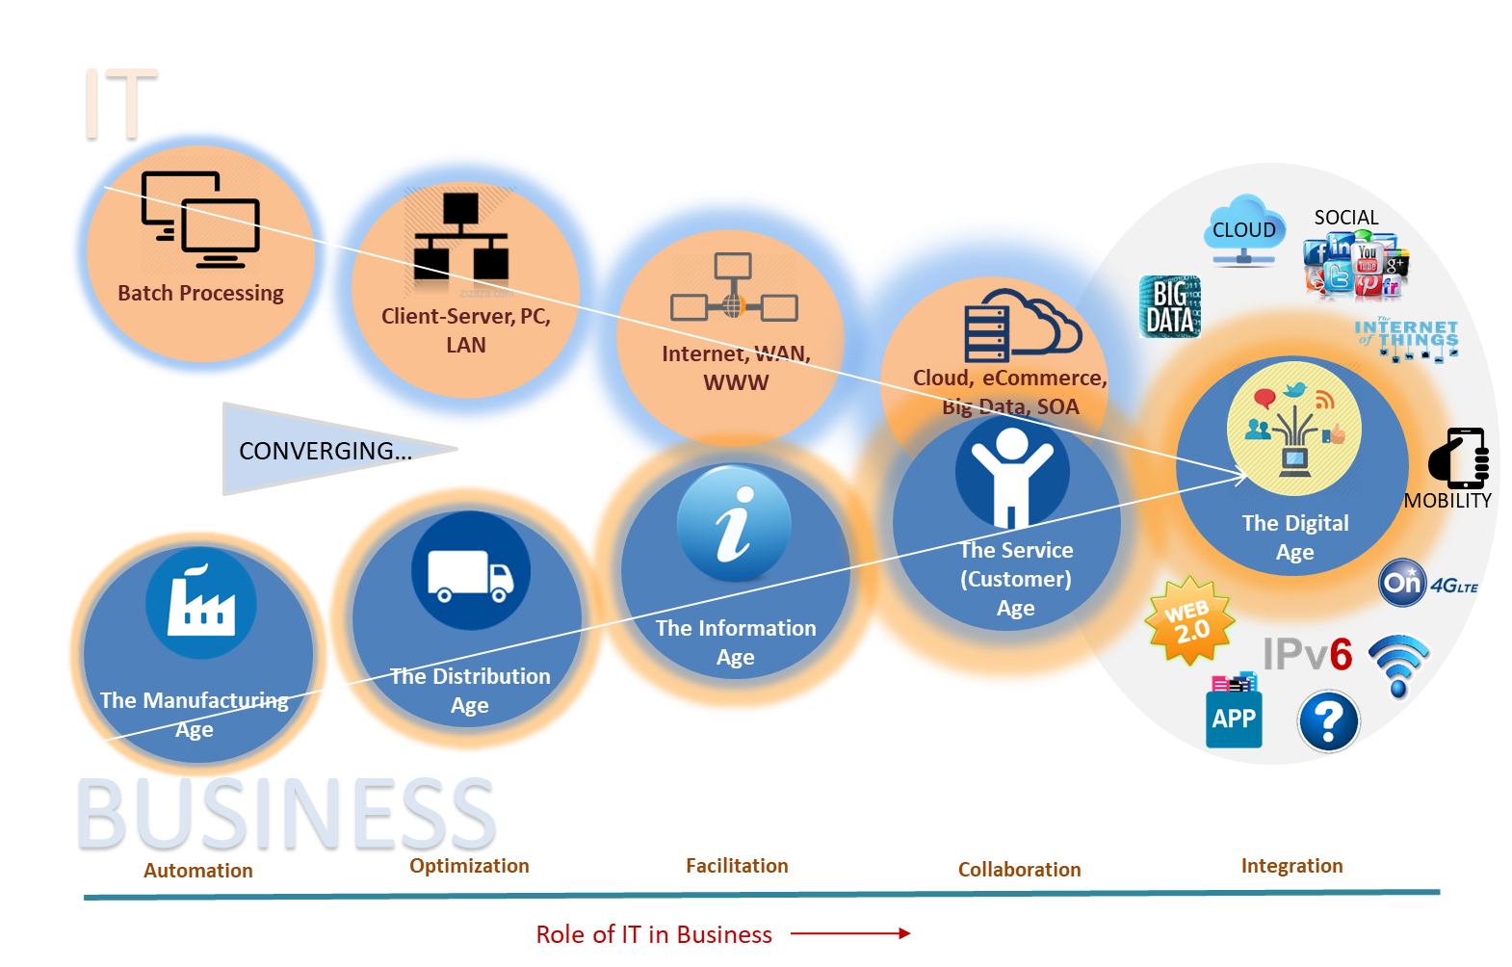
The Convergence that created the Digital Economy
Industry 1.0 [18th Century]
Steam Power, Mechanization
Industry 2.0 [19th Century]
Electricity, Railroad, Telegraph
Industry 3.0 [Mid 20th Century]
ICT, Electronics
Industry 4.0 [Today]
Advanced Robotics, 3D Printing, IoT/M2M, Digital Technology, AI and ML…
© Ashish Pachory

Slide 11
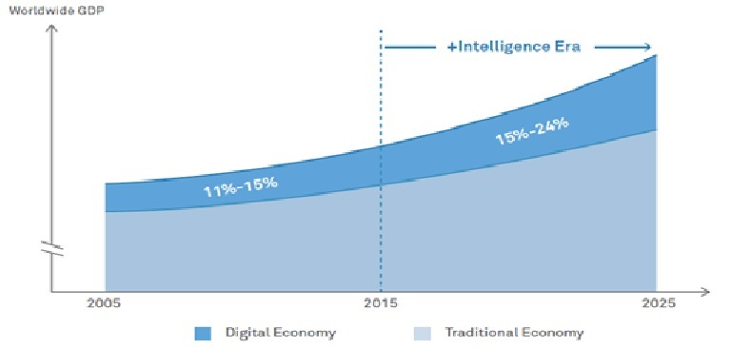
In spite of phenomenal growth in digital business, the digital economy still has vast untapped potential that opens up huge opportunities for innovation-led growth.

